Slide 1
Effects of volatile substances in the air of active beehive in patients with asthma and COPD
Zorica Plavšić MD PhD MPH
Apitherapist
plavsicz@yahoo.com
Second International Apitherapy Congress in Poland,
24-25 September 2022

Slide 2
Biography
Education:
School of Medicine, Belgrade University, Srbia, 1977.
MA studies in Alergology and Clinical Immunology, Medical Faculty of the Belgrade University, 1981.
Specialization in Pneumophtysiology, Medical Faculty of the Belgrade University, 1983.
PhD degree, Medical Faculty of the Belgrade University, 1987.
Two months medical training in Cleveland, Ohio, USA, at the Cleveland Clinic and Mary Mountain Hospital, May – Jun 1986.
MA studies in Public Health, SPH - Loma Linda University, California 2004-2007.
Working experience:
1987 – 2010
Institution: Belgrade City Institute for Lung Diseases and Tuberculosis Prevention
Position: Specialist Physician, 1987 – 1989.
Head of Department for Alergology and Clinical Immunology, 1989 -2008.
Head of the Prevention Center, 2008-2010.
Professional manager for the courses accreditaion:
Apiteraphy Course in 2013; 2015;
Strengthen Health Potential With Healthy Lifestyles in 2014;
Apiteraphy, Modern Method of the Tradicinal Medicine in Improving Integrative Health Care in 2017.

Slide 3
Statement of Disclosure
Information provided in this presentation are not intended to treat disease, or individuals. Each patient is an individual case for itself and should be diagnosed by a healthcare professional.

Slide 4
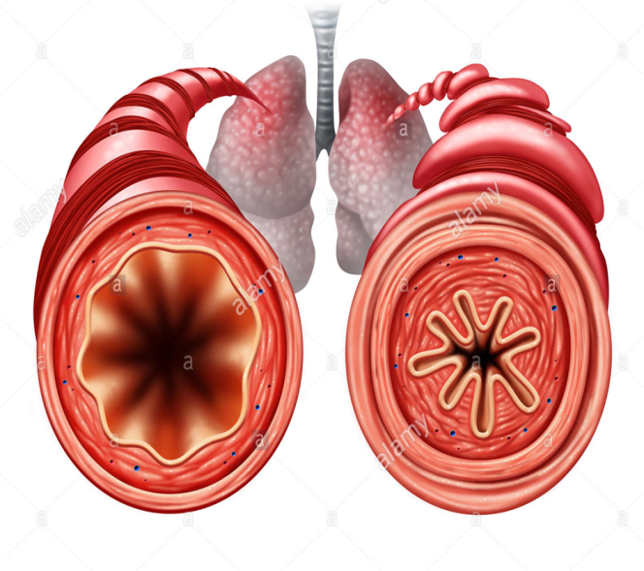
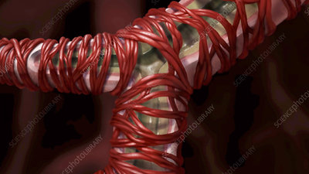
Introduction
The main cause of symptoms in asthma COPD or allergic sneezing is hypersensitivity of the mucosa and bronchial hyperresponsiveness.
Bronchial hyperresponsiveness (BHR) is defined as excessive bronchial narrowing and manifests itself as an exaggerated bronchoconstrictor response of the airways to various inhaled stimuli.
Normal
Nerow

Slide 5
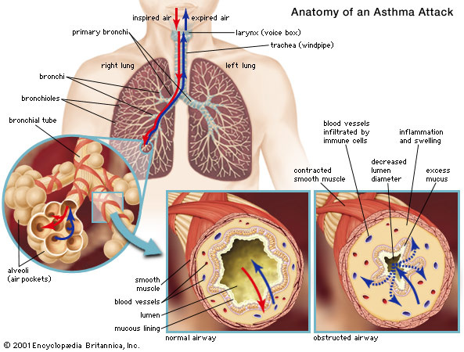
Bronchial hyperreactivity
Bronchial hyperreactivity (BHR) is an important measure of airway lability in asthma and may be measured by bronchial challenge, commonly after exercise, after inhalation of cold air or with pharmacologic stimuli such as methacholine.

Slide 6
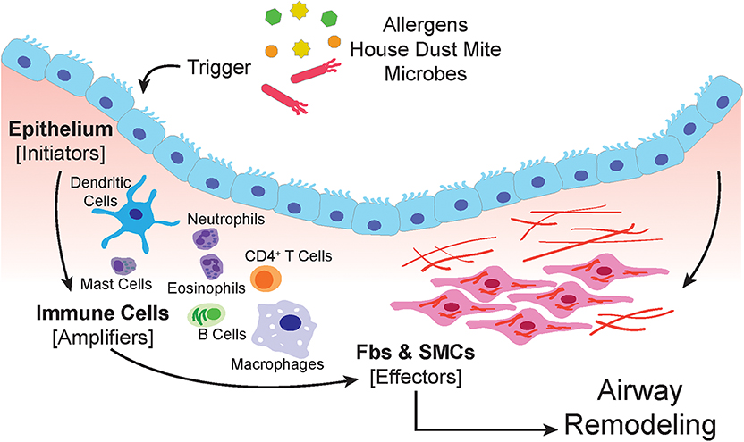
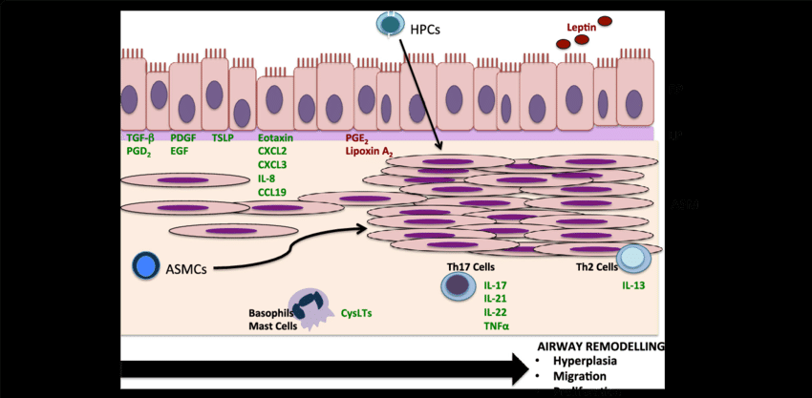
Airway remodelling
The airways of asthmatic individuals are characterized by a T-helper cell - Th2 profile inflammation consisting of an overabundance of eosinophils, mast cells and Th2 lymphocytes. These inflammatory cells release mediators that trigger bronchoconstriction, mucous secretion and remodelling (structural change)

Slide 7
Volatile substances in the air from active beehive of Apis mellifera spacies
Bees maintain a constant temperature in the hives around 35˚ C. That warm, moist air from the hive contains a large number of volatile substances originating from honey, propolis and wax.
In practice, it has been shown that controlled inhalation of these volatile substances can achieve positive effects in the prevention, treatment and prevention of exacerbations in Asthma, COPD and pollen allergy.

Slide 8
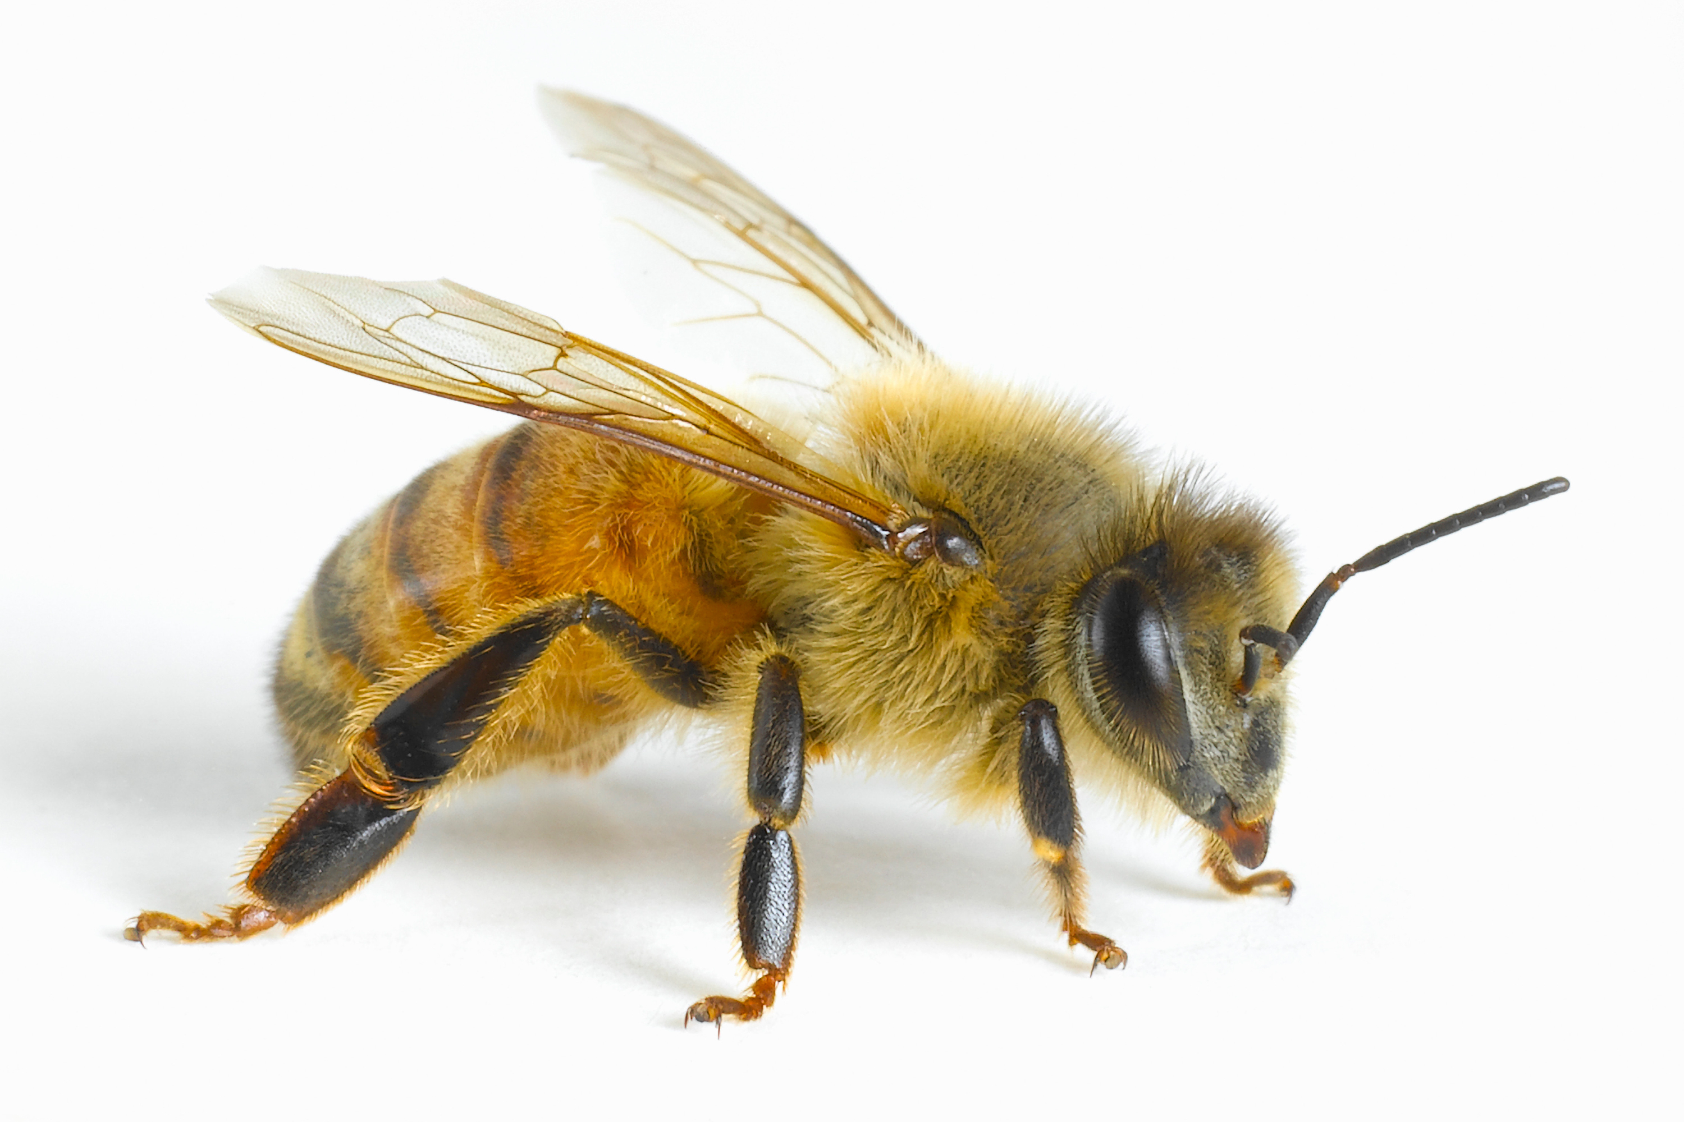
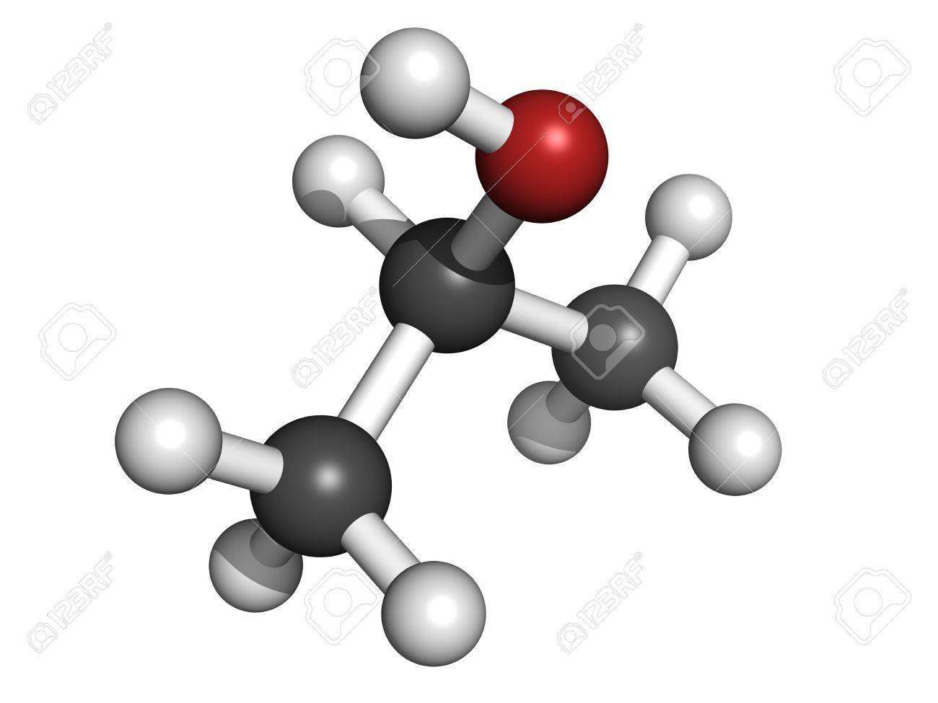
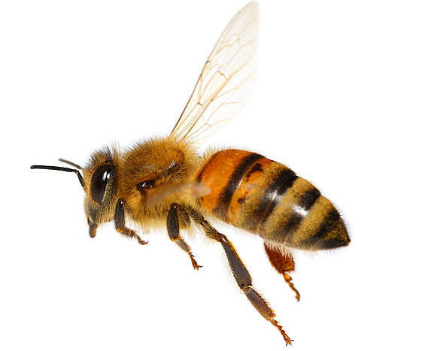
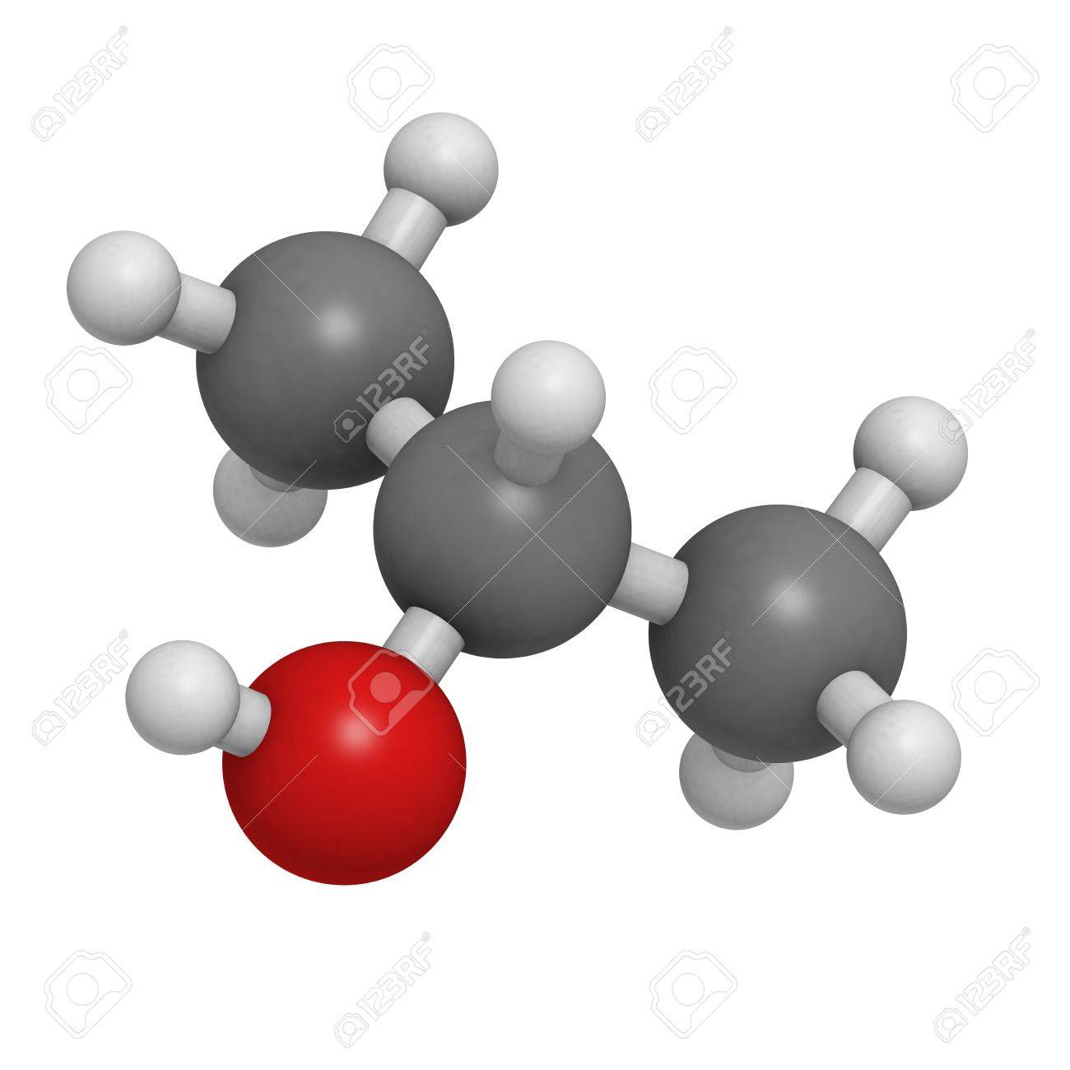
Composition of air from active hives
JUPITER
With their movement and work in the hive, bees create a warm, healing aerosol with a specific smell of essential oils from bee products.
Different authors report between 44 to 56 volatile compounds from beehives.
SATURN
It’s a gas giant and the biggest planet in the Solar System
Saturn is a gas giant, composed mostly of hydrogen and helium
Main particles in the air from the hive are: oxygenated hydrocarbons, nitrogenous hydrocarbons, alcaloids, fatty acids, lipids, steroids (hormons), isoflavonoids, carotenoids, terpenes, essential oils, pheromones, alcohols, enzymes, antibiotics, phytohormones producessed by bees
This planet is the smallest one in the Solar System

Slide 9
WAX | HONEY | POLLEN | PROPOLIS | ROYAL JELLY | VENOM
Hydrocarbon | Aldeids | Phenolic Compounds | Phenolic Compounds | Amphiphatic acids | Melitine
Fatty acids | Ketones | Aminoacids | Flavonoids | Phenolic Compounds | Phisphlpase A2
Esters | Acids | Hydrocarbons | Terpens | Sugars | Apamina
Alcohols | Alchohols | Esters | Esters | Proteins | Histamine
Diols | Hydrocarbons | Alcohols | Sugars | Fatty acids | Peptideos
Palmitic acid | Esters | Sugars | Hydrocarbons | Minerals | Hyaluronidase
 | Phenols | Fatty acids | Minerals | Carboniled Compounds
All these volatile compounds, in their own way, contribute to the reduction of hyperreactivity of the mucosis and muscles of the bronchi.
Tiago Guardia de Souza e Silva. Therapeutc Inhalation of beehive’s air – Characterizing the volatile
components present in the air of beehive of Apis mellifera species. 46th Apimondia. Canada. Montreal.
Quebec.September 2019.

Slide 10
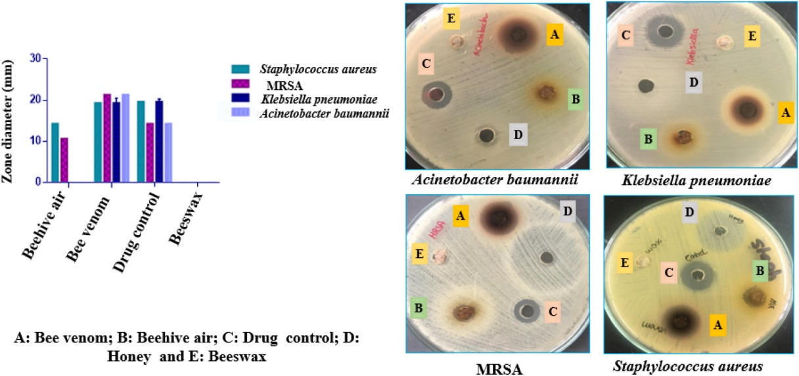
Antimicrobial activity
Aida A.Abd El-Wahed at all. Unravelling the beehive air volatiles profile as analysed
via solid-phase microextraction (SPME) and chemometrics. Journal of King Sauad University-
Science. Volume 33 Issue 5, July 2021, 101449

Slide 11
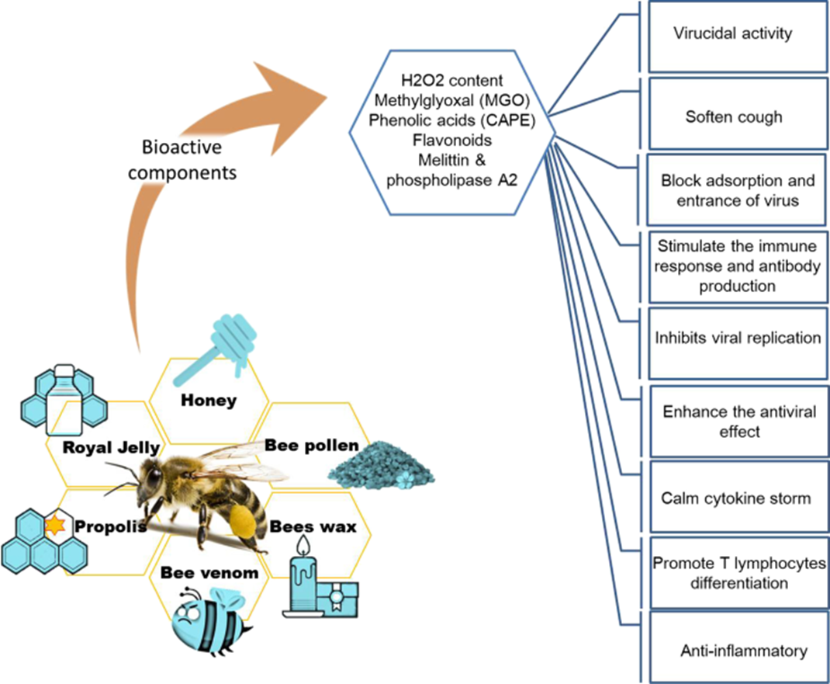

Slide 12
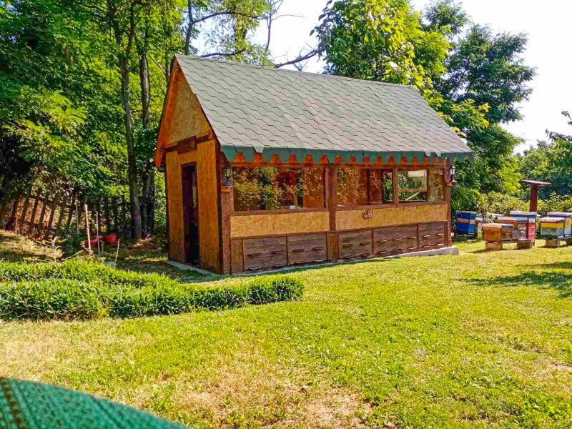
Recomendations
Inhalations in apichamber should be performed from April/May to September, depending on the weather. It is performed primarily on warm, sunny days when bees collect nectar.
1
2
3
The temperature in hive betveen 35-37⁰C is ideal to achieve the optimal content of volatile substances in the air.
Due to people who are allergic to pollen, follow the pollination calendar for the area where the apichamber is located. Flowering of plants in the immediate vicinity of the apichamber should also be monitored.
1
Therapy should be always performed in cooperation with a physician, or a doctor of alternative medicine and apitherapist.
4
In apichamber, patients should wear clothes made of natural materials, without shoes, ( in socks made of natural materials.)
5

Slide 13
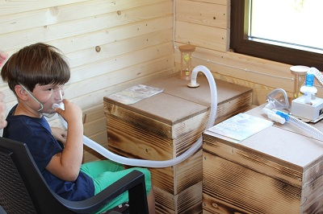
Pharmacists agree that a drug has the best effect when we can put it directly on the affected area. This is exactly the condition we meet when patients with respiratory problems breathe air directly from the hive.

Slide 14
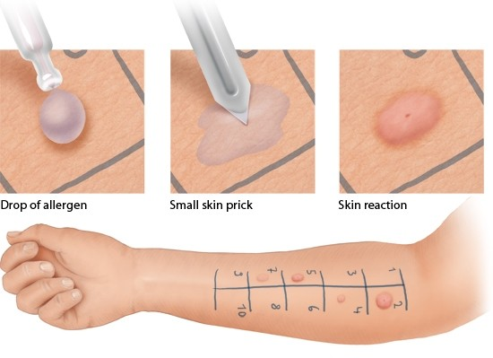
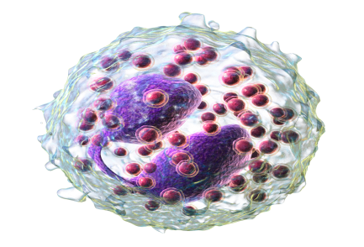
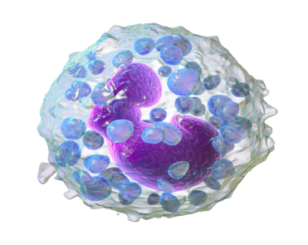
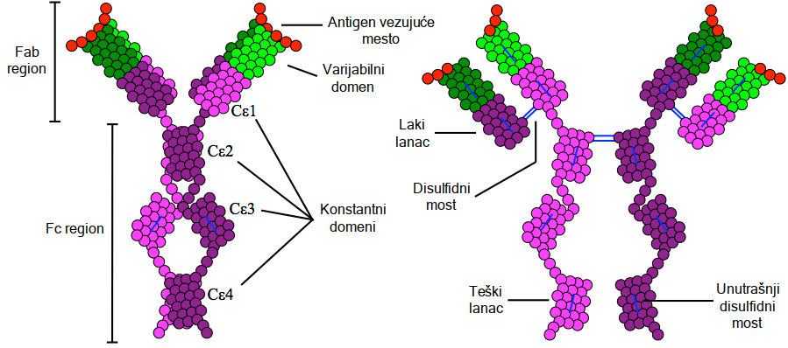
Before the inhalation.....
Skin PRICK test
Informations about the onset of the disease, symptoms, and possibly hereditary are necessary to define the scope and duration of treatment.
It is necessary to examine the possible existence of allergies to bee products, especially bee venom and bee pollen.
The examination include
skin PRICK test,
the number of eosinophyls and basophils in the blood (type of white blood cells),
total amount of IgE immunoglobulin,
RIST test for bee venom - the total amount of specific IgE immunoglobulin for bee venom.
Eozinophyles
Basophyles
When these tests are negative, it gives security to the apitherapist that no side effects will occur during inhalation.
Notes:
When these tests are negative, it gives security to the apitherapist that the patient is not allergic to the components of the air from the hive and that no side effects will occur during inhalation.

Slide 15
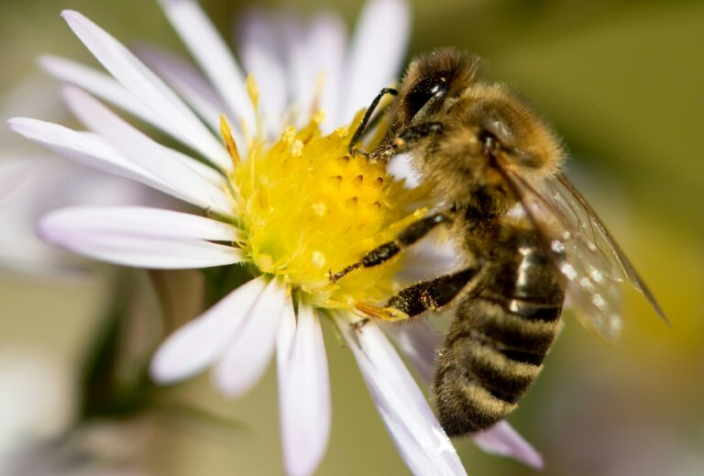
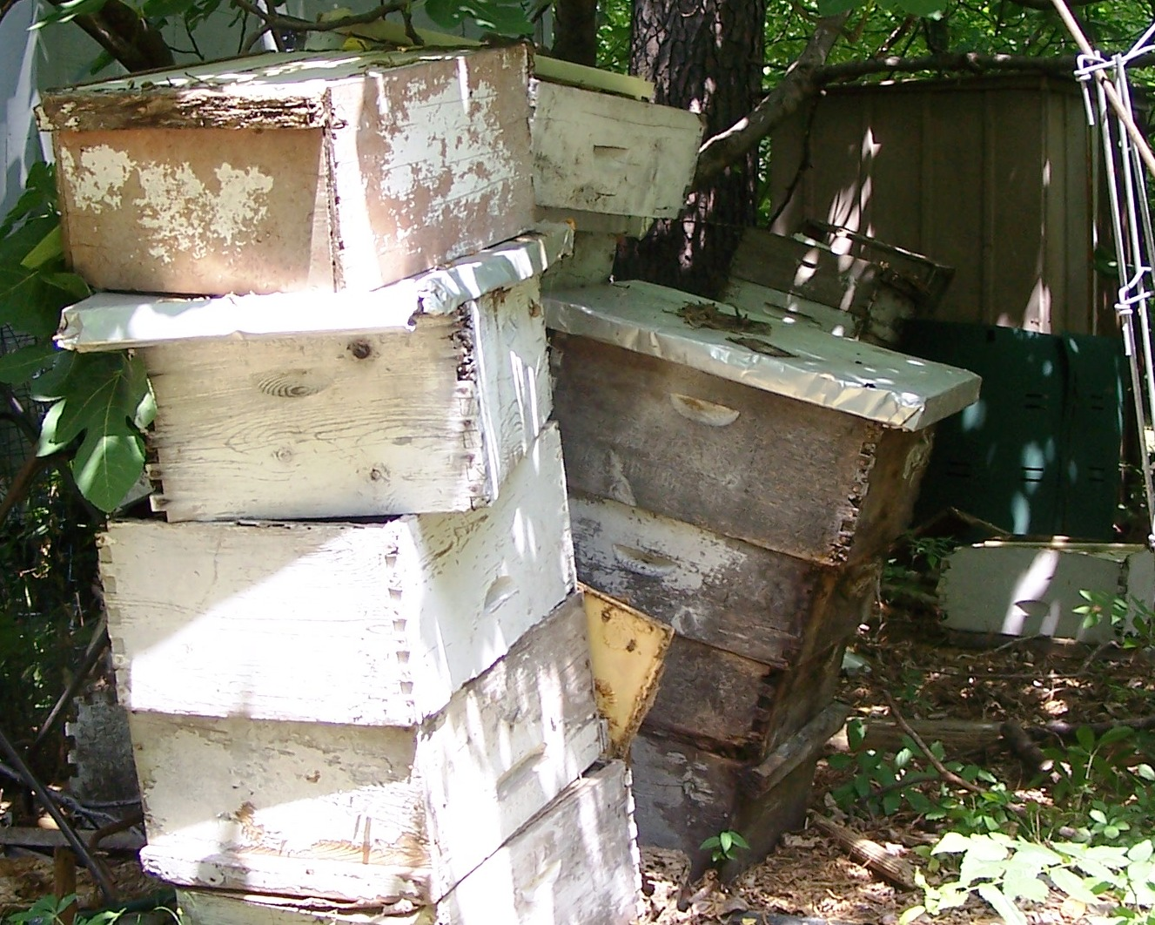
Conditions for best air quality from the hive
Good and healthy bee colony
Proper hive ventilation to protect the bee colony from overheating or moisture retention and condensation.
High degree of hygiene in the hive is provided by the bees themselves.
Quality of bee products in the hive
Type of hive matherial
Type of the material of which the apichamber is built
High degree of hygiene in the chamber
Daily desinfection of the chamber and inhalation systems

Slide 16
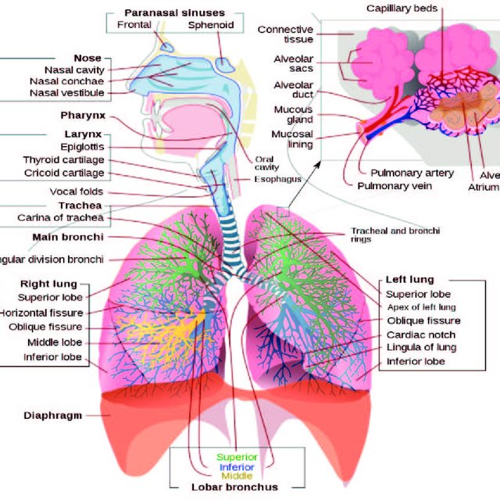

Slide 17
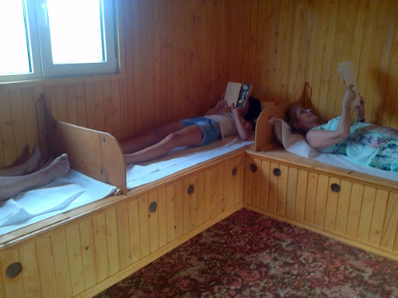
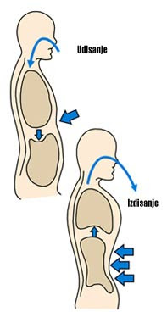
Inhalation methods
As a prevention
When individuals are in remsion of the disease or helthy persons.
Playing some games, reading, or doing breathing exercises (few mi. ) - at least half an hour to several hours a day, 10 days.
Repeat theinhalation therapy several times during the season.
The positive effects of the inhalation therapy last for six to eight weeks.
The hives should be opened at least 3 hours before the arrival of the user so that the air from the hives fills the
room.

Slide 18
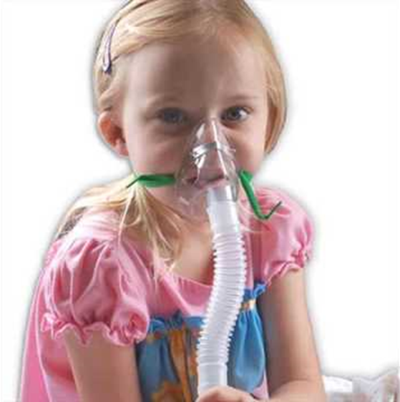
Children with BHR
Inhalation should be with special designed inhalation systems
with a mask.
Start with inhalations when first symptoms appear.
NEVER DURING THE ASTHMA ATACK
2 x 10 min, within 10 to 15 days.
Use only equipment that is designed and constructed for inhalation
in apichambers.
Additional therapy
Honey, propolis, in age-appropriate doses, orally.
Inhalation of an water solution of honey and
propolis using an ultrasonic inhaler
Medicaments - acording to specialist presciption.

Slide 19
Health benefits of volatile supstances from bee hives
Positive effects on general condition
Coclusiosns
1
2
Positive effects on individuals suffering from BHR, asthma, or COPD
3
Effects on immunomodulation
4
Antioxidative, antibacterial, antiviral, and antifungal effects.

Slide 20
Suggestions for future activities
Beehive air aromatherapy has a positive effects in the treatment of respiratory tract disorders such as BHR, asthma, bronchitis, ect.
It would be best if we could determine the chemical requirements of air from the hives in certain apichamber.
Further investigations are also needed to examine other biological effects of beehive air and determination of real function of these volatiles and their actual role in the treatment.
1
3
5
2
4
2
Further investigations and well documented clinical studes on larger number of patients are needed
Profiling air from beehives from different localities or from bees reared on different crops, or different climate, could provide stronger information on variations in volatiles compounds.

Slide 21
Bibliography
1. Tago Guardia de Souza e Silva. Therapeutc Inhalation of beehive’s air – Characterizing the volatile
components present in the air of beehive of Apis mellifera species. 46th Apimondia. Canada. Montreal.
Quebec.September 2019.
2. Kapš P. Lečenje pčelinjim proizvodima- apiterapija. Zagreb Geromar d.o.o. 2012.
3. Plavšić Z. One of the authors of the chapter “Broncial Asthma” in the 6th edition of the textbook “Lung
diseases” by Prof. Dušan Popovac. Colorgrafx. Beograd 2004. 176-250.
4. Plavšić Z. Coauthor in the monography “Ambrosia” by prof. dr Vaskrsija Janjić, 1st edition in 2006. The author
of the chapter “Alergy Diseases Caused by the Ambrosia Pollen”;
5. Aida A.Abd El-Wahed at all. Unravelling the beehive air volatiles profile as analysed via solid-phase
microextraction (SPME) and chemometrics. Journal of King Sauad University- Science. Volume 33 Issue 5, July
2021, 101449
6. Gupta RK, Stangaciu S. Apitherapy: Holistic Healing Through the Honeybee and Bee Products in Countries
with Poor Healthcare System. In: Beekeeping for Poverty Alleviation and Livelihood Security. Dordrecht:
Springer Netherlands; 2014; 413-46.

Slide 22
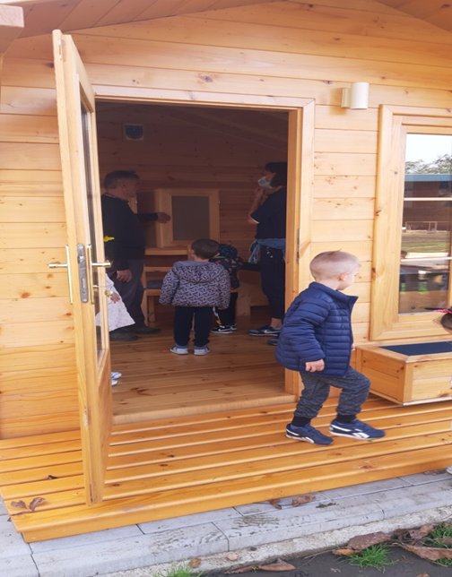
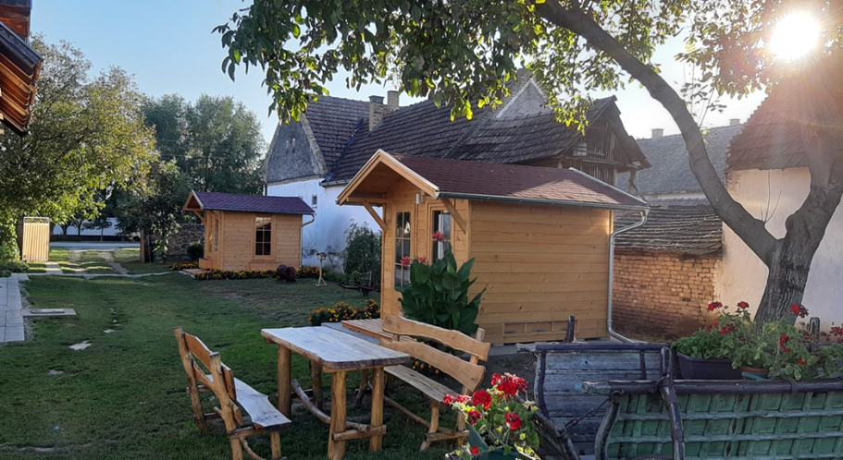
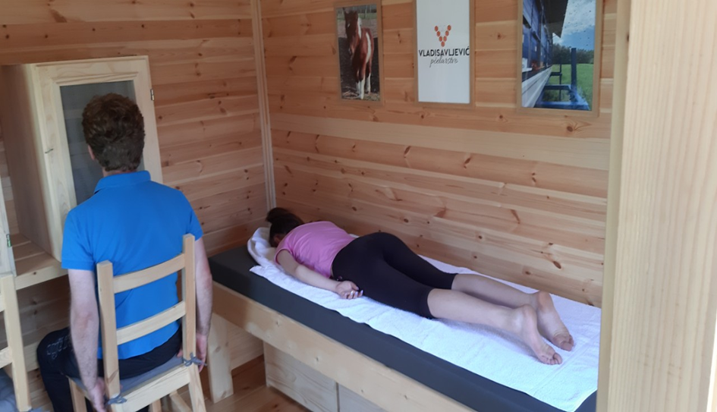
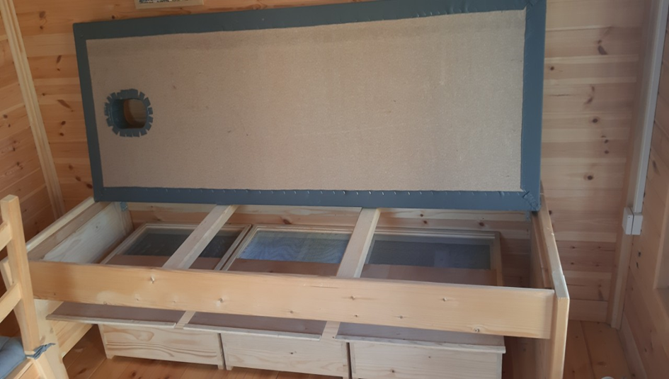
H

Slide 23
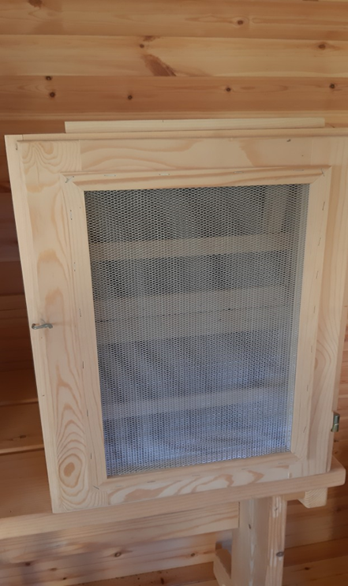
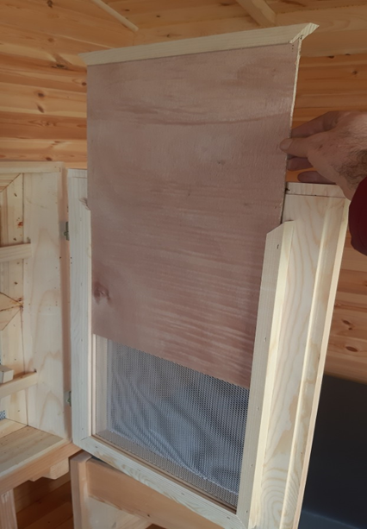

Slide 24
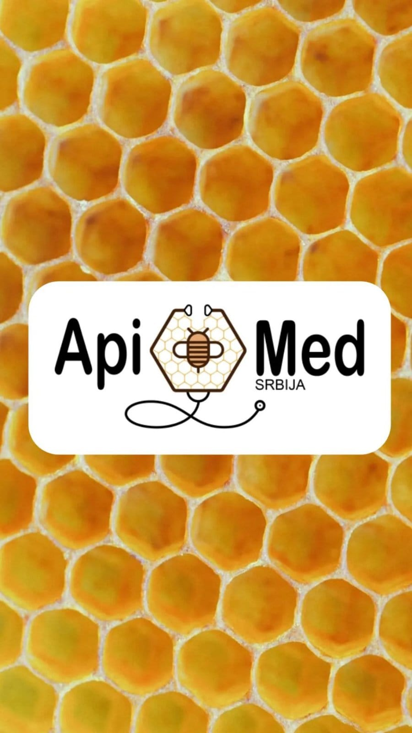
Thank you for Your attention
Zorica Plavšić MD PhD MPH Apitherapist
First International Medical Society for Apitherapy Serbia
Mobile: +38164 5467716
apimedsrbija@gmail.com
https://www.apimedsrbija.rs

